Slide 1

Welcome to Sabbath School
Illustration by Jo Card. Copyright © 2024 General Conference Corporation® of Seventh-day Adventists.

Slide 2

EARLY ARRIVALS
EARLY
ARRIVALS

Slide 3

Books of the Bible
EARLY ARRIVALS
EARLY
ARRIVALS

Slide 4
Welcome to Sabbath School
Illustration by Jo Card. Copyright © 2024 General Conference Corporation® of Seventh-day Adventists.

Slide 5

Alive in Jesus
OPENING ACTIVITIES
Welcome to Sabbath School.
It’s good to see you.
How are you today?
Let’s have some fun
As we learn about God’s love
And follow in His way.
We’re alive in Jesus.
We’re alive in Jesus.
(Repeat above)
"Alive in Jesus" by Rosie Smith, copyright © 2024 General Conference Corporation® of Seventh-day Adventists.

Slide 6
Rest of My Life
OPENING ACTIVITIES
I won’t back down,
I won’t give up.
I’ll follow Jesus
No matter how tough it gets.
No matter what the problem,
No matter what the strife,
I’m with Jesus for the rest of my life.
(Continued on next slide)

Slide 7
Rest of My Life
OPENING ACTIVITIES
Because I won’t back down,
I won’t give up.
I’ll follow Jesus
No matter how tough it gets.
No matter what the problem,
No matter what the strife,
I’m with Jesus for the rest of my life.
(Repeat above)
I’m with Jesus for the rest of my life.(x2)
"Rest of My Life" by Kimberly Houliston, copyright © 2009 Abide Family Ministries. Used by permission.

Slide 8
Sabbath Song
OPENING ACTIVITIES
He made us, He saved us,
He’s coming back to take us home.
(Repeat two times)
Jesus, You are welcome in this place.
Father, You are welcome in this space.
Holy Spirit, fill our hearts with grace.
In this palace of time and space.
(Repeat above)
In this palace of time and space.
"Sabbath Song" by Alexandria and Leighton Heise, copyright © 2020, Alexandria and Leighton Heise. Used by permission.

Slide 9

PRAYER
PRAYER

Slide 10
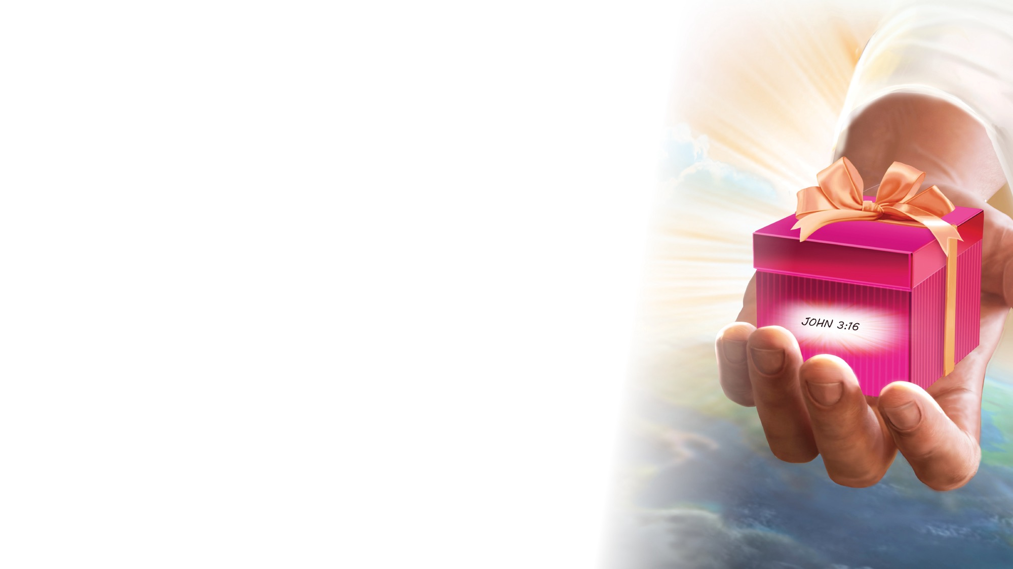
OFFERING

Slide 11

Thank You, Jesus
OPENING ACTIVITIES
Thank you, Jesus
For providing all my needs.
I want to give a little back
Of what you’ve given me.
Please bless our
Sabbath School offering.
May it bring You glory
And help others in need.
(Repeat above)
May it bring You glory
And help others in need.
"Thank You, Jesus" by Rosie Smith, copyright © 2024 General Conference Corporation® of Seventh-day Adventists.

Slide 12
MISSION
FAST FACT &
OFFERING
CHART

Slide 13
Visitor Song
OPENING ACTIVITIES
We have a new friend
With us today.
We have a new friend.
Let’s smile and wave.
We welcome you to Sabbath School.
We’re glad you came.
We welcome you,
And hope to see you again. (x2)
“Visitor Song” by Rosie Smith. Copyright © 2025 General Conference Corporation® of Seventh-day Adventists.

Slide 14
Happy Birthday
OPENING ACTIVITIES
Happy birthday, happy birthday,
Happy birthday to you.
Jesus loves you dear ___________.
Happy birthday to you.
(Repeat above)
“Happy Birthday” by Janet Sage, copyright © 2001 North American Division Corporation of Seventh-day Adventists. From Little Voices Praise Him, #39. Used by permission.

Slide 15

FOCUS
ACTIVITIES

Slide 16
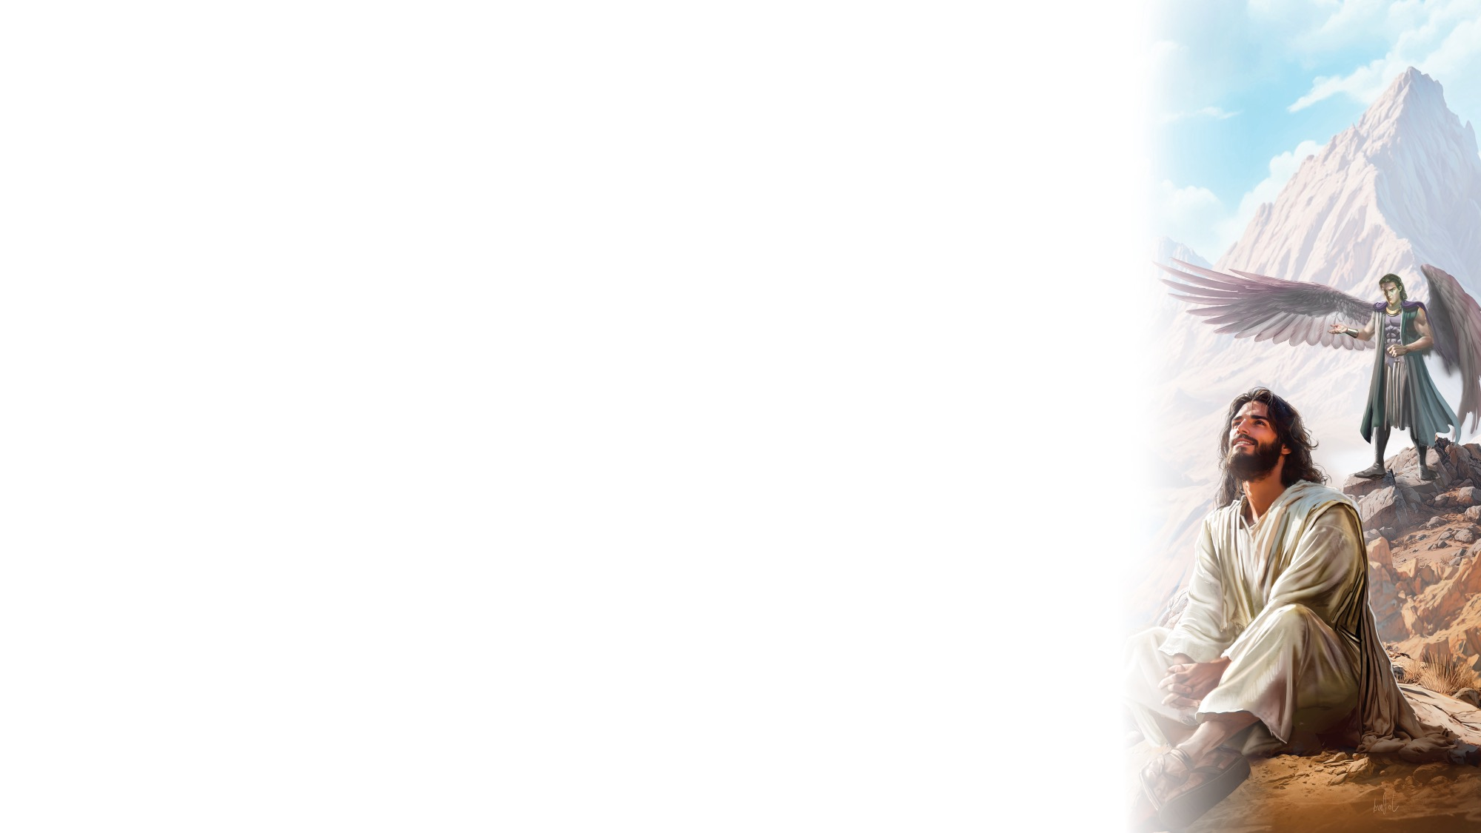
BIG IDEA
I can rely on God and His power to help me when
I am tempted.

Slide 17

BIBLE
STORY

Slide 18
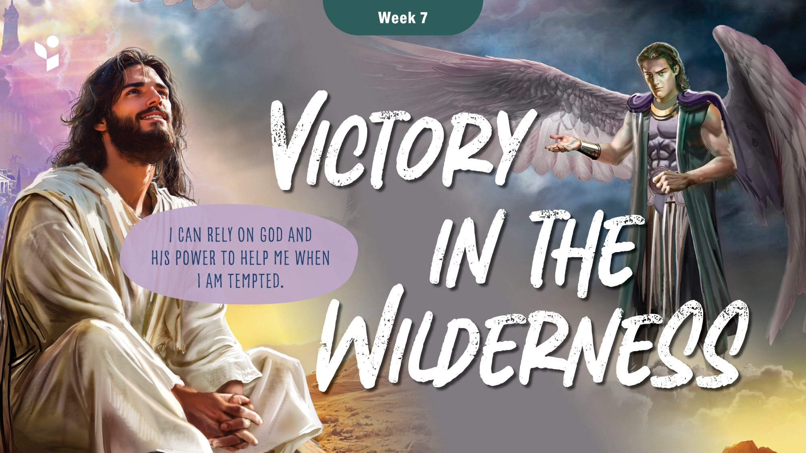

Slide 19
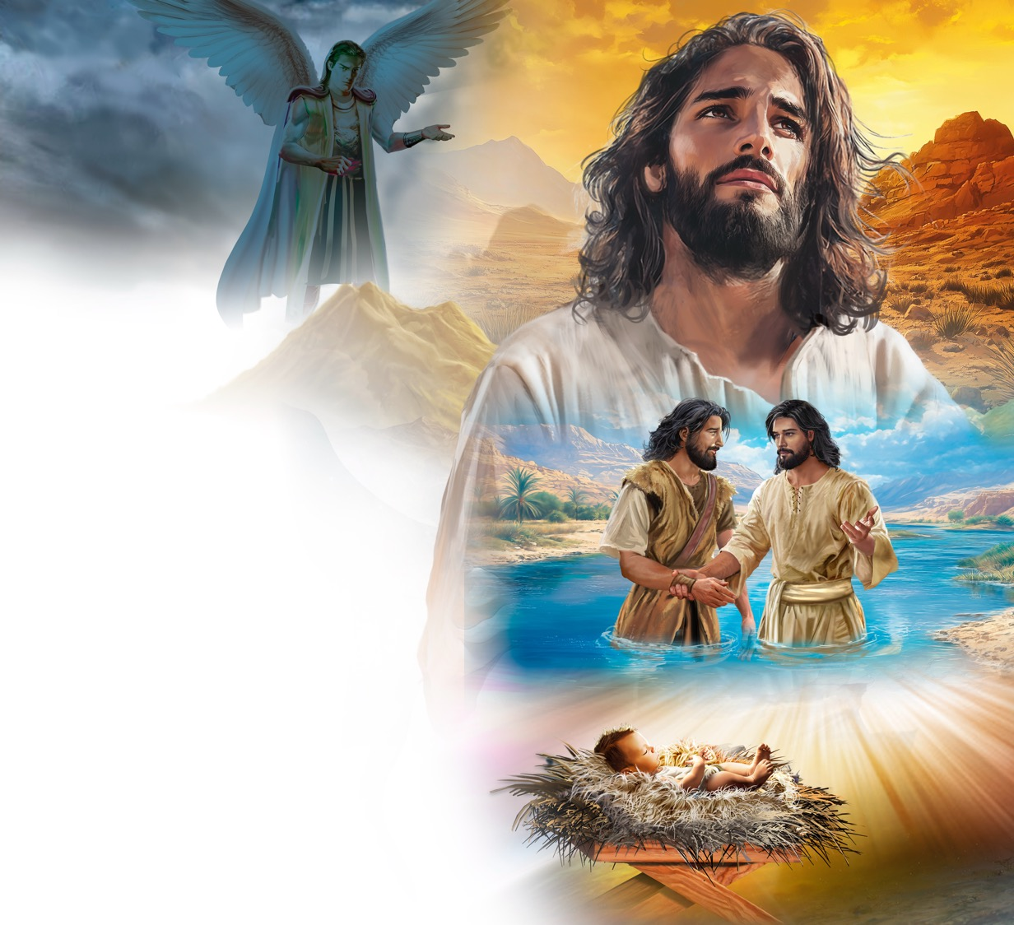
Illustration by Jo Card. Copyright © 2024 General Conference Corporation® of Seventh-day Adventists.

Slide 20
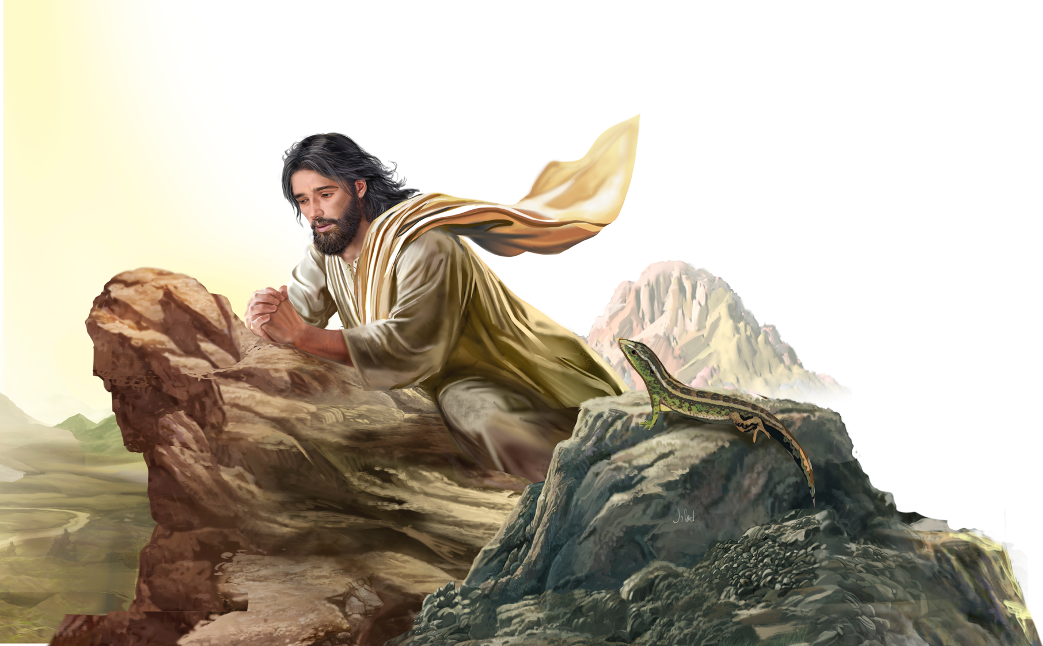
Illustration by Jo Card. Copyright © 2024 General Conference Corporation® of Seventh-day Adventists.

Slide 21
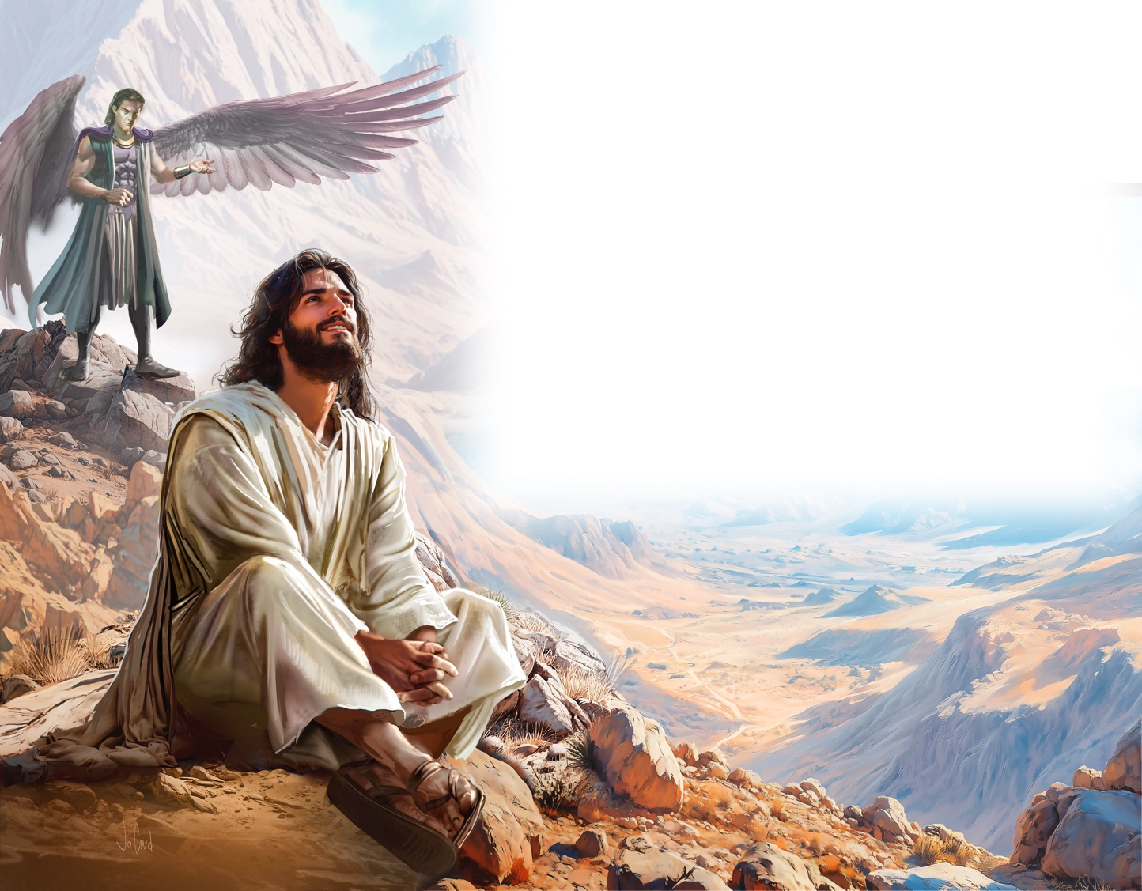
Illustration by Jo Card. Copyright © 2024 General Conference Corporation® of Seventh-day Adventists.

Slide 22
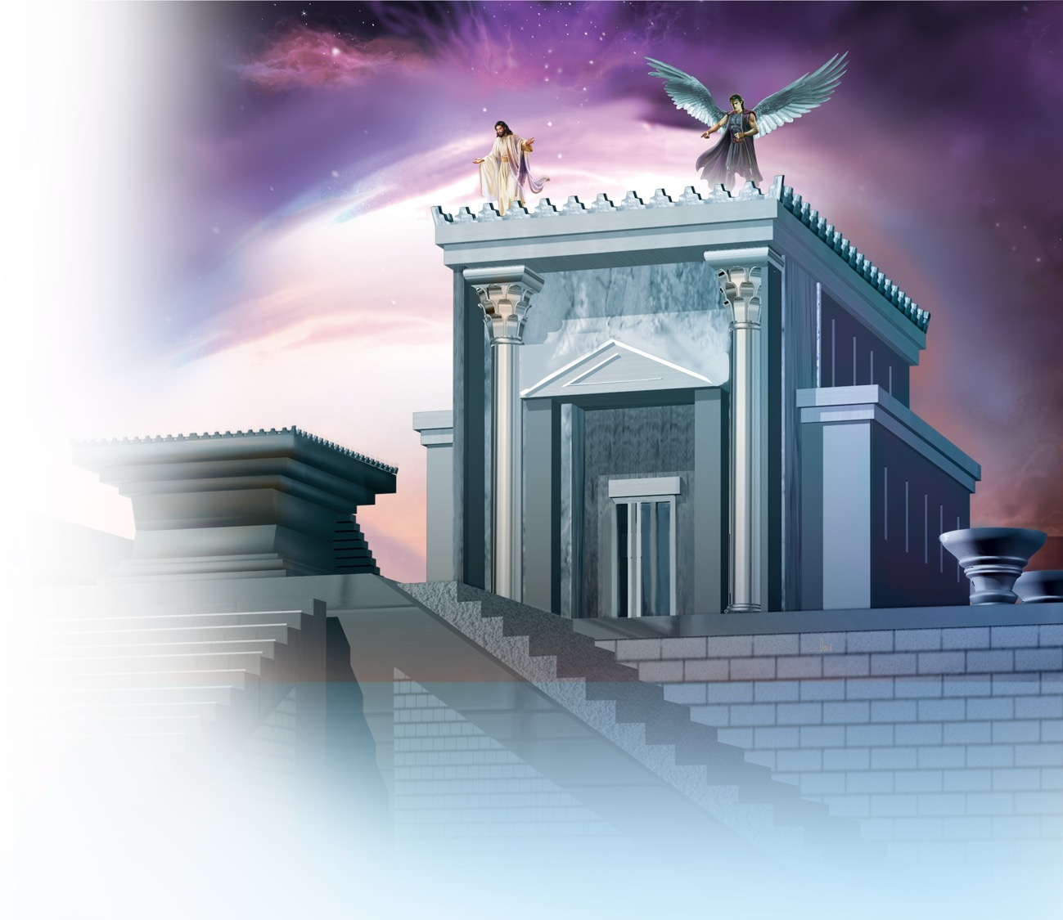
Illustration by Jo Card. Copyright © 2024 General Conference Corporation® of Seventh-day Adventists.

Slide 23
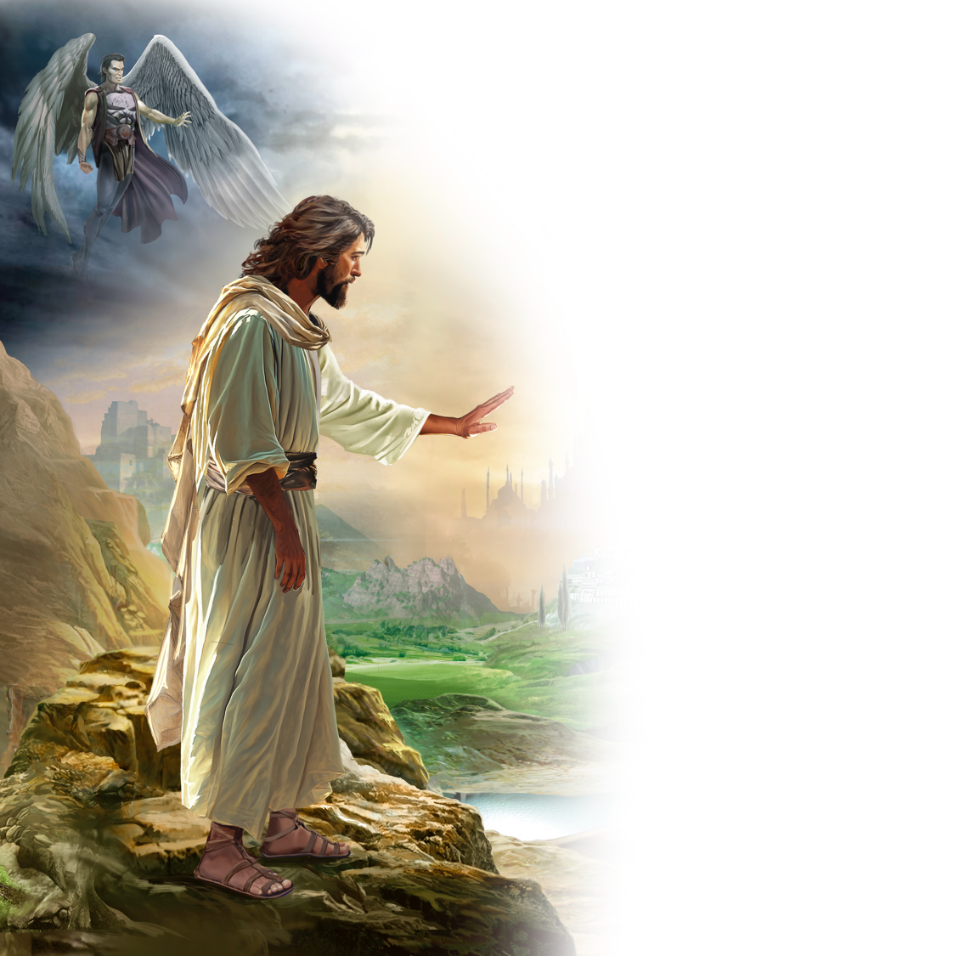
Illustration by Jo Card. Copyright © 2024 General Conference Corporation® of Seventh-day Adventists.

Slide 24
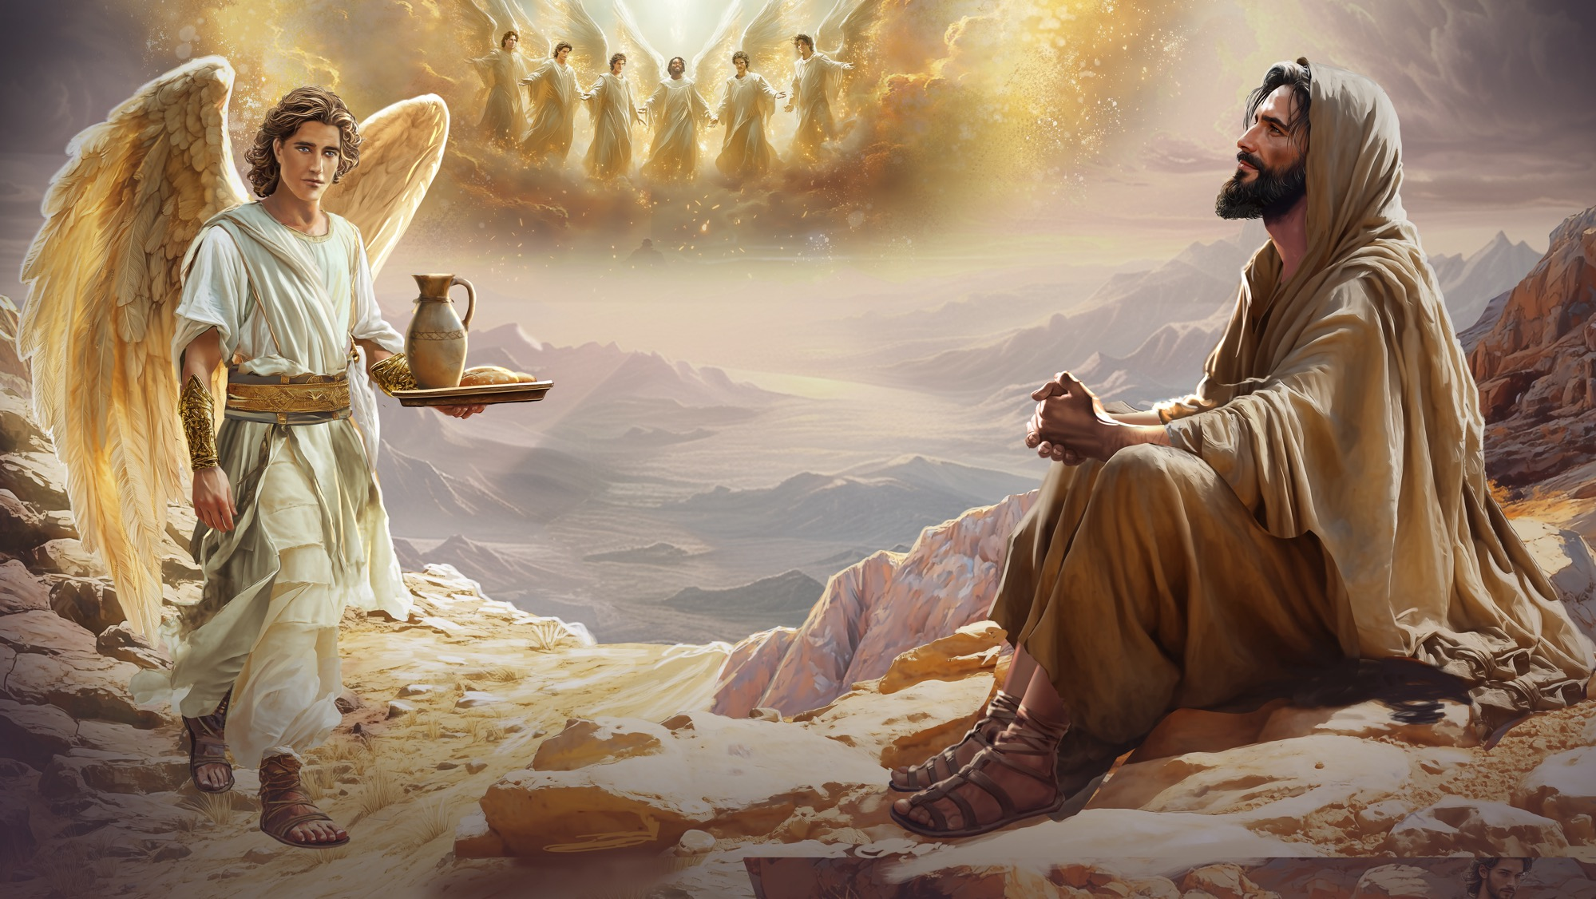
Illustration by Jo Card. Copyright © 2024 General Conference Corporation® of Seventh-day Adventists.

Slide 25
UNPACK
THE STORY

Slide 26

CHARACTER CARDS

Slide 27
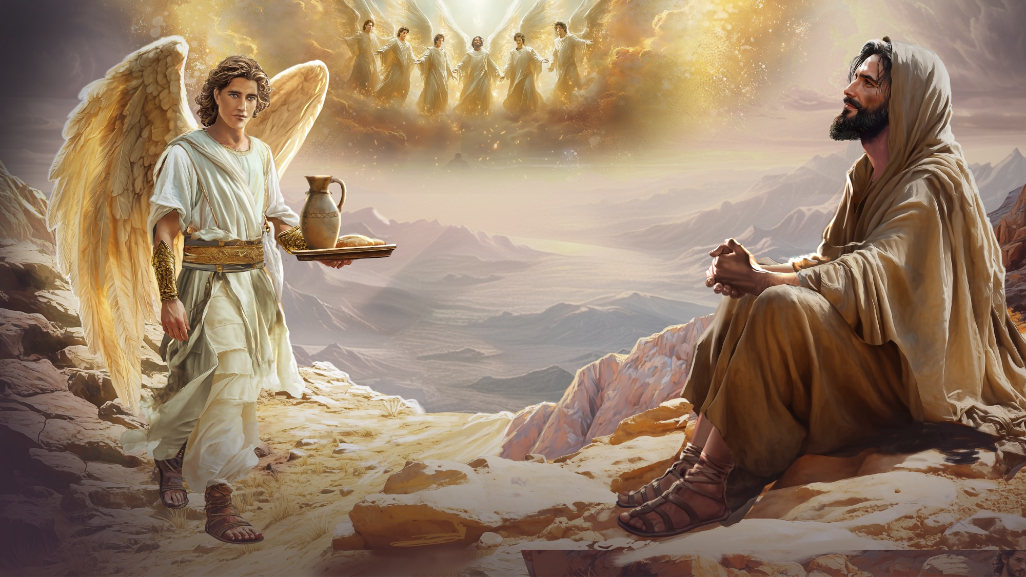
MEMORY VERSE
“But thanks be to God, who gives us the victory through our Lord Jesus Christ.”
1 Corinthians 15:57

Slide 28
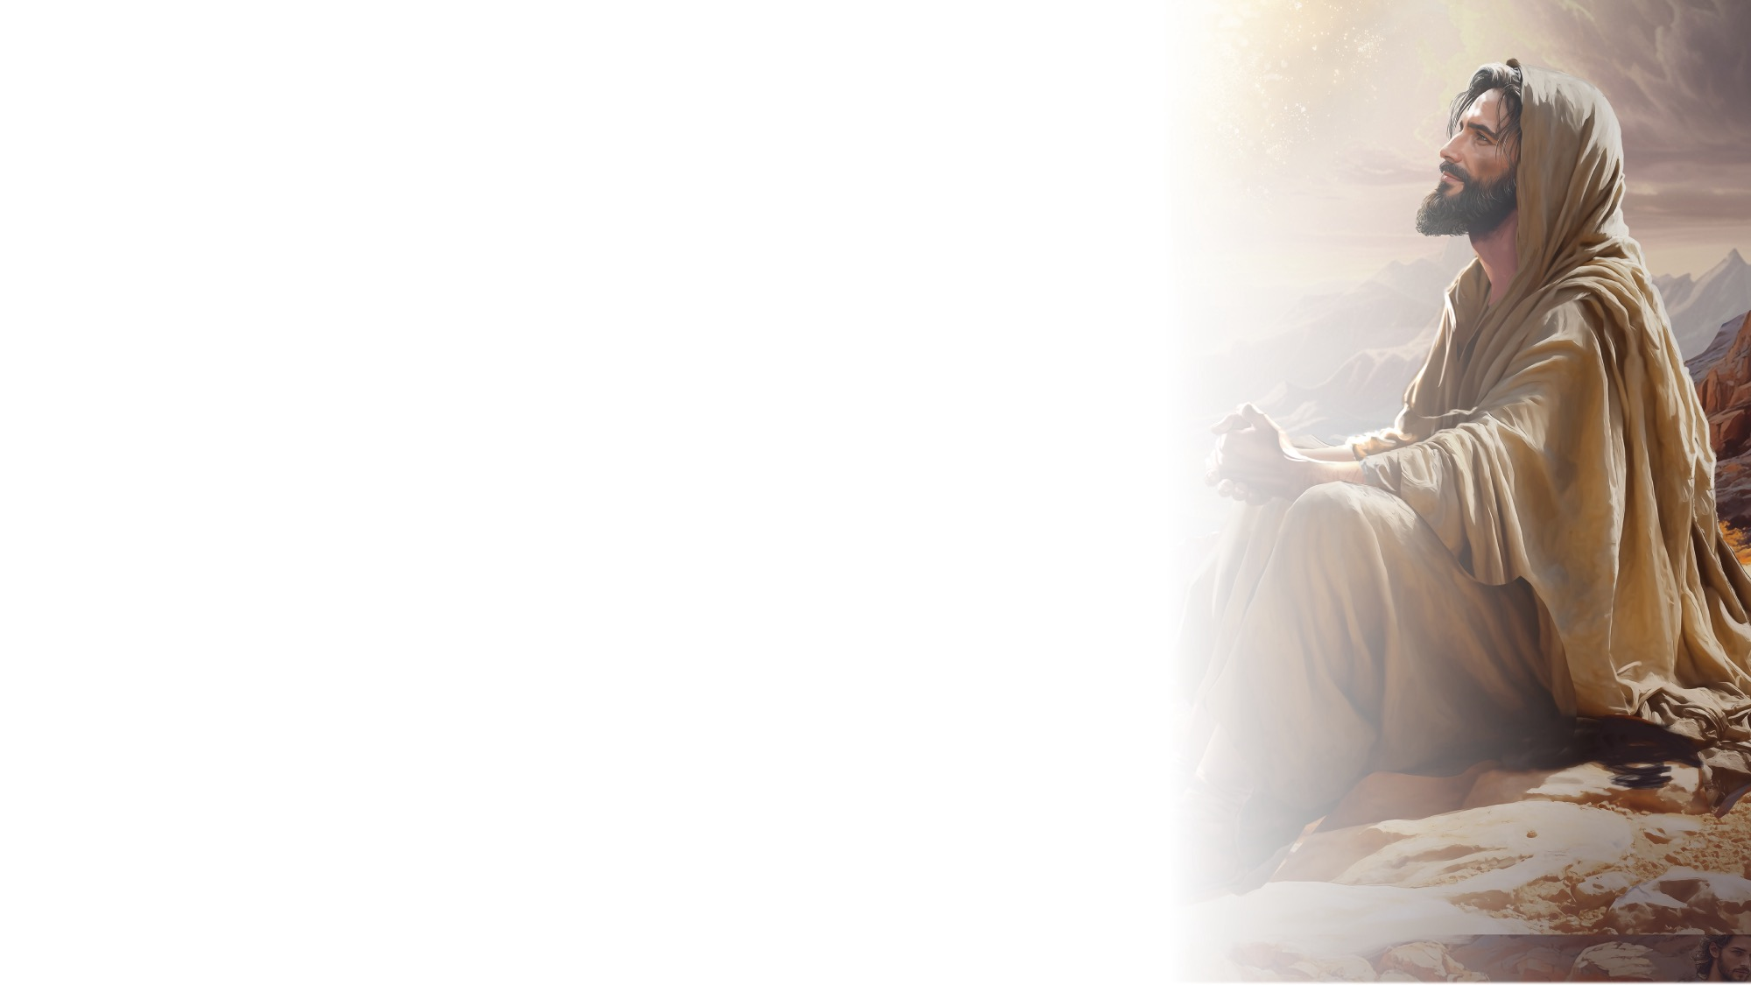
1 Corinthians 15:57
SCRIPTURE SONG
But thanks be to God,
Who gives us the victory
Through our Lord Jesus Christ.
First Corinthians 15:57
(Repeat above)
"1 Corinthians 15:57" music by Rosie Smith, copyright © 2026 General Conference Corporation® of Seventh-day Adventists.

Slide 29

MISSION
STORY

Slide 30

CRAFT

Slide 31
MISSION
CHALLENGE

Slide 32
BIG IDEA
I can rely on God and His power to help me when
I am tempted.

Slide 33

PRAYER
PRAYER

